Slide 1

Tulsa TechFest X - 2015

Slide 2
RESTful WebAPI/Database interactions
James Huckaby
Software Architect
RelayHealth, a McKesson company

Slide 3

Please be courteous!

Slide 4
Introduction
James Huckaby
Software Architect at RelayHealth
http://jameshuckaby.com
@raveller on twitter
SQL Server development
Established 1999
IIS development
Classic ASP / COM development since 1999
2006 Classic ASP -> ASP.NET Atlas/Ajax 2
2010 ASP.NET MVC / JSON, JQuery
2013 ASP.NET WebAPI 2, CORS, AngularJS

Slide 5
What this session isn’t:
This is not an AngularJS session
This is not a CORS session
This is not a “Code-First” Web API session
This is not an Entity Framework only session

Slide 6
What this session is:
This is a Database-First Web API session
This is a SOLID design in Web API session
This is a RESTful Web API session
This is a session that discusses
What is the easy way?
What is the hard way?
What is the right way?

Slide 7
RESTful interactions
HTTP Verb -> CRUD -> SQL
GET –> Read -> SELECT
POST -> Create -> INSERT
PUT -> Update -> UPDATE
DELETE -> Delete -> DELETE
HTTP Headers
Accept & Content-Type
application/xml
application/json
Custom?

Slide 8

What do we get “for free”?

Slide 9
The “Easy” way – part 1
How does the ASP.NET site tell you to do it?
Make a WebAPI
Hook up Entity Framework
Add individual controllers for each data type
A+ is awarded (Not quite)
Let’s do this!

Slide 10
The “easy” way – part II
What do we get?
Everything is tightly coupled
There is no separation of “Model” and “View”
2 major facets of SOLID are ignored.
Single responsibility -> Nope
Dependency Inversion is ignored
In a mature, enterprise product, what did we get “for free”?
Your DB Operations team that haven’t been able to Profile Nhibernate with their expensive toolset now have to figure out if they can Profile Entity Framework either.
Your Dev team that has to support upgrades on 20 “Let’s prototype it and see how it works out” efforts now has to support 21.
Experienced DB developers may now spend time diagnosing production problems with ORM code versus SQL they can deliver fixes to more rapidly.

Slide 11
The “hard” way
Let’s decouple the Data from the Presentation like we learned in the 90’s
Let’s pretend that .NET Class Libraries are easy, because they are.
Let’s wrap our DB Models in “Domain models”, DTO’s, MVC, MVVM or whatever the current rebilling is.
Let’s wrap our Database business interaction in Data Access components that have interfaces so I can swap them out later if I want to.

Slide 12
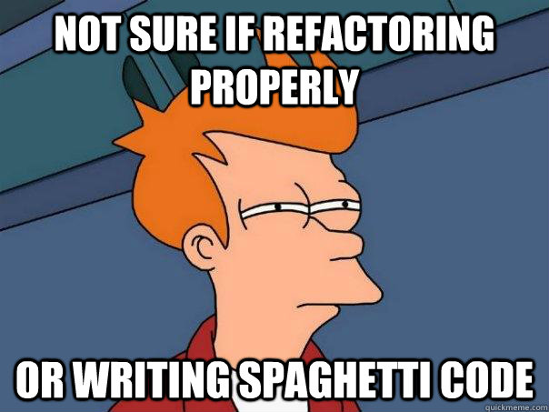
The “right” way?

Slide 13



